Slide 1
Computer Software
...Durodola K.A

Slide 2
What is Software?
Software are programs which give instructions to the computer
Types of Software
1. System sofware
2. Application software
3. Utility Software

Slide 3
System software e.g Operating System
System software is a program designed to run a computer's hardware and applications and manage its resources, such as its memory, processors, and devices. It also provides a platform for running application software, and system software is typically bundled with a computer's operating system.

Slide 4
Operating systems
An operating system are program which manages hardware within a computer system. When a computer is turned on and after the Basic Input/Output System (BIOS) has loaded,
the operating system is the first piece of software that will
load. It sits between hardware and applications software
and manages any communication between the two.

Slide 5
Functions of an Operating System
An operating sys tem mana ges har dwa re by ca rr y ing out tasks such as:
Allocating memory to software
Sending data and instructions to output devices
Responding to input devices such as when a key is pressed
Opening and closing files on storage devices
Giving each running task a fair share of processo time
Sending error messages or status messages to appl icatio ns or users dealing with user logins and secur ity .

Slide 6
What is Application Software
Application software are programs that are intended for productivity or to carry out a task for the user . Examples include word processor, spreadsheet, database sofwares, games, web browser, video editing sofwares, photoediting sofwares, communication softwares, web ediitng softwares, control and measuring software and graphics software . Apps,on a mobile phone or tablet.

Slide 7
Applets
An app let is a small program that is designed to carry out a spec ific task . An apple t cannot run on its own but must be executed from within another piece of software . Applets are often know n as add -ins, add-ons or extensions . They can carry out add itional tasks that the or·iginal software is not capable of doing or they can simplify tasks within the original software .
TASK
Explore some of the extensions available to Google Chrome and add-ins available to Microsoft Excel.

Slide 8
Different types of user interface
An interface is the boundary between two systems . A user interface is the boundary between the user and the computer system . A user interface represents the communication between a user and the computer system.
This communication can take many forms .
Command line interface
A comma nd line interface (CLI) allows a user to enter text commands to wh ich the computer system will respond. The computer system will respond by producing results in a text format.

Slide 9
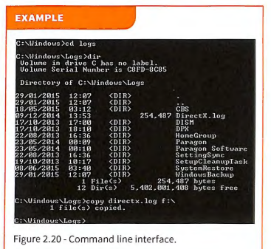
CLI

Slide 10
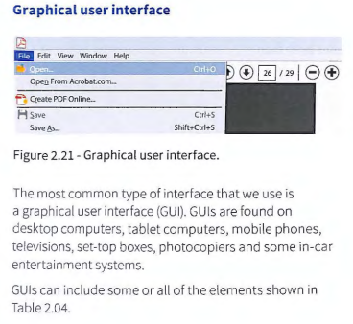
Graphic User Interrface

Slide 11
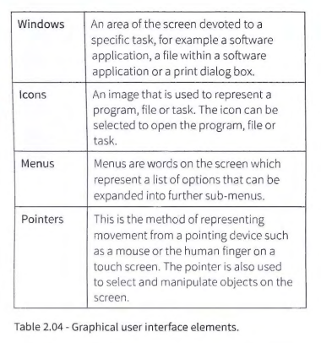
GUI Elements

Slide 12
Dialogue Interface
A dialogue interface refers to using the spoken word to
communicate with a computer system . A user can give
co mmands using their voice and the computer system
can respond by carrying out an action or wit h fu rther
informa tion using a synthesised voice.

Slide 13
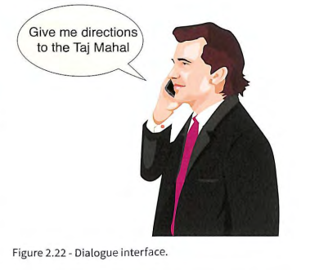
DIalogue User Interface(DUI)
Dialogue interfaces are very pop ular with mobile
devices,including mobile phones and in-car
entertainment systems. Some cars will accept commands such as
'Temperat ure 20' or 'Call John Smith at home '. Mobile
phones will accept commands and quest ions such as
'Wha t is the time in Islama bad?' or 'Give me directions
to get home' . Some automa ted telep hone systems w ill
recognise voice, too, so tha t the user does n't have to use
the dia l pad to inp ut info rmat ion.

Slide 14
Gesture -based interface
Gesture-based interfaces will recognise human motion . This cou ld include tracking eyes and lips, identifying hand signals or monitoring whole body movement. There are many applic ations of gesture -based interfaces, includin g gaming, which have led to the development of other gesture-based interfaces.
The original Nintendo Wii enabled gamers to move their hands while holding a remot e controll er and that movement would be mimicked in games such as ten pin bow ling and boxing . Microsoft 's Xbox took thi s a stage further and was able to track who le body movement without any devices being held or worn by the user.

Slide 15
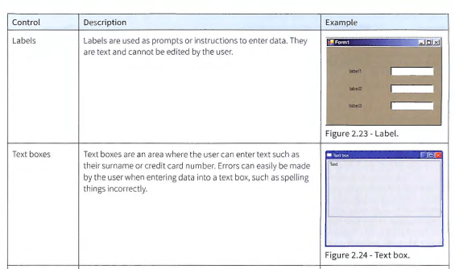

Slide 16
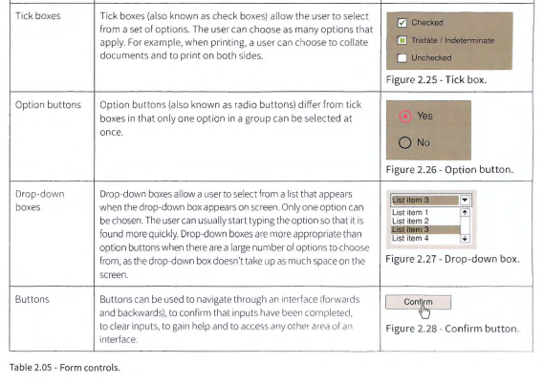

Slide 18
Utlity Software/Device Drivers
A computer's utility software includes components that assist the operating system to optimize, maintain, organize and manage how it functions.

Slide 19
Common Utility Software Examples
Antivirus Software.
Disk Cleaners.
Backup Software.
File Compression Software.
System Utilities.e.g calculator,
Antivirus.
File Management System.
Disk Management tools.
Compression tools.
Disk cleanup tool.
File Management System.
Disk Defragmenter.
Backup utility.

Slide 20
Device Drivers
While the operating system can manage the general instructions to deal with hardware such as displaying graphics on a screen, it requires the use of device drivers to deal with specific makes and models of hardware. A device driver is the software that comes with an external hardware component and sends customised instructions to that specific component.
By using common device drivers, software applications are able to issue generic commands such as 'print' to the operating system without having to know the different instructions required for every different make and model of external hardware components.

Slide 21
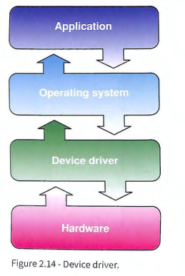
Device Driver flow Diagram

Slide 22
Utilities
Utilitie s are part of system software. They are designed to perform functions wh ich maintain the computer system .
Compilers
A compiler translates a program written in a high-level programming language into machine code which a computer can understand . The file containing the
machine code is known as an executable file because it can be executed by the processor. It can also be referred to as the object file. The original high- level programming language file is known as the source file.

Slide 23
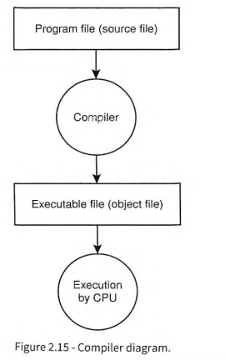
Compiler Diagram

Slide 24
Interpreters
Interpreters also translate a program written in a highlevel programming language into machine code, but use a different method. Instead of translating the whole source code at once, it is translat d one line at a time . This can be less efficient th an a comp iler beca use it takes ti me to do the translating as the program is being executed and also because statemen t s within programming loops (e.g. FOR, REPEAT, WHILE) have to be analysed each time round.
Interpreters are often used to translate macros or application-based script languages (e.g. Visual Basic for App lica tions), whic h can be particularly useful when a doc um ent nee ds to be ope ned on a var iety of operating system s. Interpreters are also used when testing program s so that part s of the program can be execut ed witho ut having to co mpil e the whole program .

Slide 25
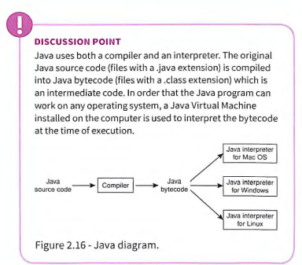
Interpreter

Slide 26
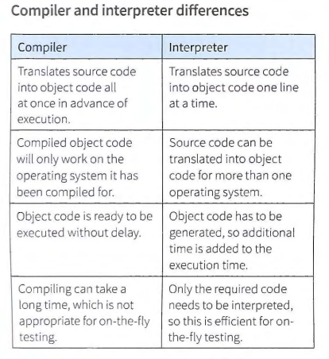
Compiler and Interpreter

Slide 27
Linkers
Computer programs often consist of several modules (part s) of programming code . Each module carries out a specified task within the program . Each module will have been comp iled into a separate object file. The function of a linker (also known as a link editor) is to combine th e obj ect files together to form a single executable file. In addition to the modu les used , th e progra m may make reference to a common library.
A common library contains code for common tasks that can be used in more than one program, such as mathema tic al fu nct ions, memory management, open and save dialogues, progress bars and input / output. The linker is able to link modules from a library file into th e executable file, too.

Slide 28
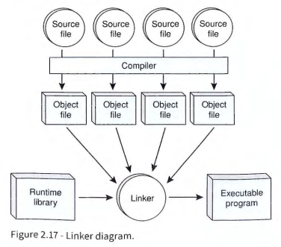
Linker

Slide 29
Custom-written versus off the-shelf software
Custom-written: software that is written especially to meet the requirements of a client
Off-the-shelf : general purpose software available to a large market When a client requires a software solution that will carry out a specific purpose that is unique to their organisation, they will ask for the software to be written for them. This is known as custom -written software because it is customised to the needs of the client and will meet the requirements of the client. When softwa re already exists and is purchased on line or from a shop, it is known as off-the-shelf software . The software will have been written for a general purpose tha t is likely to be useful to a large market. Anybody can purchase the software for a specified price.

Slide 30
